Slide 1
CG1112
Week 6 – Studio 2
Timer (tick tock tick tock)

Slide 2
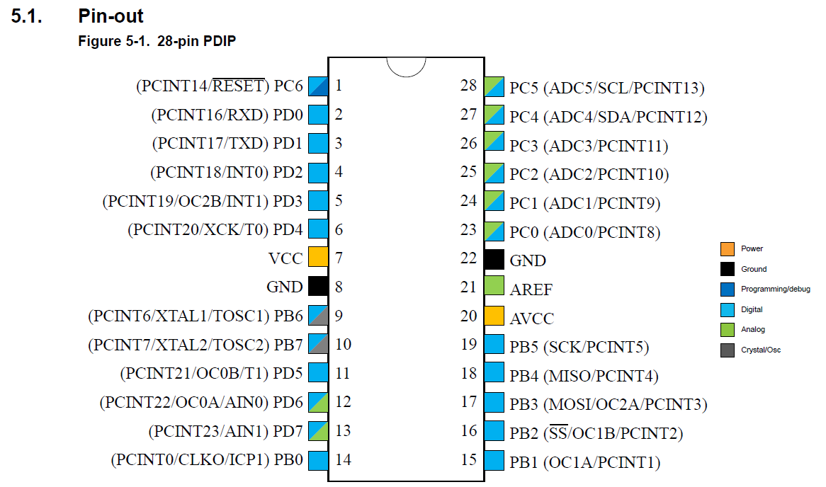
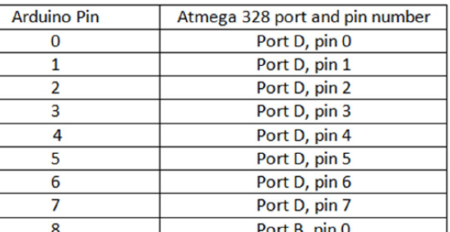
Oh, OC0A is PD6, which is Pin 6??

Slide 3
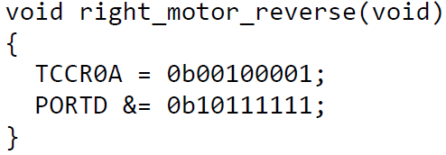
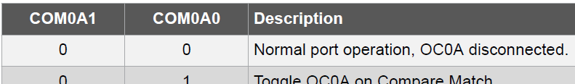
OC0A interaction with PD6
 | 7 | 6 | 5 | 4 | 3 | 2 | 1 | 0
PORTD

Slide 4

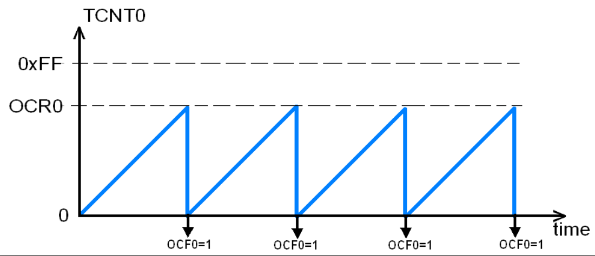
Clear Timer on Compare (CTC)
Frequency ➔ Duration
Prescaler

Slide 5
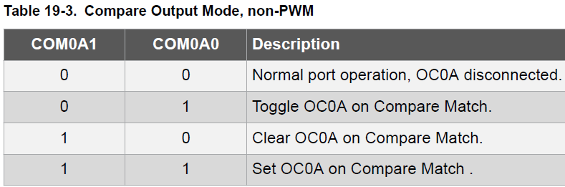

CSn2 | CSn1 | CSn0 | Description
0 | 0 | 0 | Stop
0 | 0 | 1 | clk_{IO} / 1
0 | 1 | 0 | clk_{IO} / 8
0 | 1 | 1 | clk_{IO} / 64
1 | 0 | 0 | clk_{IO} / 256
1 | 0 | 1 | clk_{IO} / 1024
TC0 and TC2
TCCRnA | CmA1 | CmA0 | CmB1 | CmB0 | 3 | 2 | WGM1 | WGM0
OCRnx (8 bit)
TCCRnB | 7 | 6 | 5 | 4 | WGM2 | CSn2 | CSn1 | CSn0
TCNTn (8 bit)
TIMSKn | 7 | 6 | 5 | 4 | 3 | 2:OCIEB | 1:OCIEA | 0
TC1 only
TCCR1A | CmA1 | CmA0 | CmB1 | CmB0 | 3 | 2 | WGM11 | WGM10
OCR1A (16 bit)
TCCR1B | 7 | 6 | 5 | WGM13 | WGM12 | CS12 | CS11 | CS10
TCNT1 (16 bit)
WGM13 | WGM12 | WGM11 | WGM10 | Mode | TOP
0 | 1 | 0 | 0 | CTC | OCR1A

